Slide 1

Department of Computer Science and Engineering
(Cyber Security)
CS23533– Foundations of Artificial Intelligence
2026-2027
ADVERSARIAL STATE-SPACE OPTIMIZATION
IN CHESS ENVIRONMENTS | REVIEW 2
Supervisor: Dr. S. Bhuvana
Assistant Professor (SG)
Team members:
Baviri Setty Sai Deevan (241901016)
Monish Priyan M (241901057)

Slide 2
Problem Statement and Motivation
▪
Chess has an enormous search space. Exhaustive Minimax is impractical at useful depths, especially under a move clock.
▪
Unstable positions create a horizon effect: stopping halfway through captures can make an unsafe move look attractive.
▪
Existing engines can be powerful but often depend on learned evaluation or hide how pruning and caching influence each decision.
▪
Our goal is a self-built, explainable classical-AI chess engine that plays legally, searches efficiently, and shows its work.

Slide 3
Objectives
▪
Model chess as a deterministic, fully observable, zero-sum problem with states, legal actions and a transition model.
▪
Build rules, SAN/FEN input, and a five-term heuristic from scratch, without ML or an external chess engine library.
▪
Use Negamax, Alpha-Beta, iterative deepening, ordering, hashing, quiescence and selective null-move pruning.
▪
Validate with perft, equivalence experiments and rated games. Achieved: 7/7 perft sets; 79/79 exact-search matches; 53 tests.

Slide 4
Project Progress Since Review 1
▪
After Review 1: implemented SAN move history and typed moves, stricter FEN validation, game clocks, premoves and a refined play UI.
▪
Matured search with guarded null-move pruning, a fixed 10 MB Zobrist transposition table and configurable draw contempt.
▪
Completed validation and benchmarking: seven standard perft positions, 53 automated tests, 17 search-test positions and 128 Stockfish games.
▪
Published the React + Web Worker app on Firebase Hosting; GitHub Actions now tests and builds before deployment.
▪
Documented the work: the Phase I report and an IEEE-format journal paper (IEEEtran), both written from the measured results.

Slide 5
Literature Survey
No. | Author(s), Year | Paper Title | Method / Algorithm | Limitations
1 | Shannon (1950) | Programming a Computer for Playing Chess | Minimax + static evaluation | Full-width trees grow exponentially
2 | Zobrist (1970) | A New Hashing Method with Application for Game Playing | XOR-based position keys | Collisions; bounded storage needed
3 | Knuth & Moore (1975) | An Analysis of Alpha-Beta Pruning | Formal α-β analysis; best case ≈ b^(d/2) | Benefit depends on move ordering
4 | Korf (1985) | Depth-First Iterative-Deepening: An Optimal Admissible Tree Search | Iterative deepening; anytime search | Shallow levels are re-searched
5 | Schaeffer (1989) | The History Heuristic and Alpha-Beta Search Enhancements in Practice | Move-ordering enhancements measured | Gains vary by position; tuning needed
Sources and limitations adapted from Phase I Report, literature review (Table 2.1).

Slide 6
Literature Survey
No. | Author(s), Year | Paper Title | Method / Algorithm | Limitations
6 | Beal (1990) | A Generalised Quiescence Search Algorithm | Selective search of tactical leaves | Extra search effort; checks remain a challenge
7 | Donninger (1993) | Null Move and Deep Search | Reduced-depth null-move pruning | Can fail in zugzwang and tactical traps
8 | Campbell, Hoane & Hsu (2002) | Deep Blue | Parallel α-β on custom chess chips | Special hardware; closed system
9 | Coulom (2006) | Efficient Selectivity and Backup Operators in Monte-Carlo Tree Search | Monte-Carlo tree search | Random play-outs weak in sharp tactics
10 | Silver et al. (2018) | A General Reinforcement Learning Algorithm that Masters Chess, Shogi, and Go through Self-Play | Self-play RL + neural-guided MCTS | Heavy training; not interpretable
These studies motivate α-β with ordering, hashing, quiescence and guarded null move — all interpretable.

Slide 7
Research Gap and Project Response
1. Literature findings
Minimax is exact; Alpha-Beta cuts search cost. Move ordering, hashing and selective search improve depth.
2. Limitations
Pruning depends on ordering; search can miss threats; neural engines and closed systems are harder to explain.
3. Refined research gap
A classroom-scale engine needs independently verified rules and a controlled, visible comparison of search optimisations.
4. Progress toward the solution
Built all core components; verified perft and move equivalence; added teaching mode and automated checks.

Slide 8
System Architecture / Proposed System
React interface
Web Worker
Search engine
Move result
Board, clocks, SAN, FEN, teaching mode
Runs search off the UI thread
Iterative deepening + Negamax / Alpha-Beta
Best move, score, depth and nodes
Move generator
Heuristic evaluation
Search optimisation
Verification & CI
Legal actions; make / unmake
5 interpretable terms
MVV-LVA, QS, null move, TT
Perft, node:test, Actions
All core game logic is self-written. The browser uses HTTPS static assets; no gameplay server or training data.

Slide 9
DFD Diagram
PLAYER
P1 · REACT UI
P2 · ENGINE WORKER
OUTPUT
Click, type SAN/UCI, choose FEN
Input, rules feedback, display
Legal moves → search → score
Board move + live telemetry
D1 · GAME STATE
D2 · SEARCH CACHE
Position, clocks, repetition history
Zobrist-hashed fixed-size table
Level 1 DFD · User requests a move; the worker reads board state and search cache, then returns a legal move and metrics.

Slide 10
Methodology / Workflow Diagram
01 · INPUT
02 · VALIDATE
03 · SEARCH
04 · OPTIMISE
05 · OUTPUT
Player move / FEN
Rules, legality, FEN
Negamax + α-β + ID
QS, TT, ordering, null move
Move + depth + score
BUILD / TEST
BENCHMARK
DEPLOY
Node test suite → perft validation
17 positions; self-play; Stockfish
GitHub Actions → Firebase HTTPS
No dataset training or preprocessing is required; chess positions are rules-based test inputs.

Slide 11
Tools and Technologies
▪
Language and engine: JavaScript (ES modules), a custom 64-square board model and self-written search algorithms.
▪
Interface: React 19, Vite 8, CSS and the Web Workers API. Search runs without blocking the chessboard.
▪
Validation: Node.js 20 with node:test (53 cases), published perft suites, benchmarking scripts and Stockfish 19 as reference only.
▪
Delivery: Git/GitHub, GitHub Actions and Firebase Hosting. No GPU, external chess library or ML dataset is required.

Slide 12
List of Modules
M1
Board and move generation
✓ Completed
M2
Five-term evaluation
✓ Completed
M3
Adversarial search
✓ Completed
M4
Search optimisation
✓ Completed
M5
UI, teaching mode and deployment
✓ Completed
M6
Verification and benchmarks
✓ Completed
Scope follows the Phase I Report module mapping (M1–M6). Open security items are in the work plan.

Slide 13
Module Implementation – Part 1
MODULE 1 · GAME RULES
MODULE 2 · HEURISTICS
64-square array · legal moves · castling · en passant · promotion
Material · piece-square tables · pawn structure · king safety · mobility
Board & move-generation logic
Heuristic position assessment
• FEN/SAN import, output and validation
• makeMove() / unmakeMove()
• Legality checked against king safety
• Returns centipawn evaluation
• White and Black piece-square orientation
• Per-term breakdown in teaching mode
Verification: self-built legal move generator matches published perft counts for all seven standard positions.

Slide 14
Module Implementation – Part 2
MODULE 3 · ADVERSARIAL SEARCH
MODULE 4 · OPTIMISATION
Iterative Deepening → Negamax + Alpha-Beta → Quiescence
Hash move + MVV-LVA, 10 MB Zobrist TT, guarded null-move pruning
Core decision loop
Implementation evidence
1. Generate legal candidate moves
2. Order moves; probe cached states
3. Search with alpha / beta cutoffs
4. Retain the last complete iteration
• 79 / 79: identical move and score vs plain Minimax for exact-search settings
• 10 MB fixed TT avoids unbounded growth
• Null-move guard protects sharp mates
Module 6 runs controlled experiments; Module 5 streams the selected move and search telemetry to the interface.

Slide 15
Preliminary Results and Discussion
Starting position · fixed depth 5
Plain Minimax
Alpha-Beta
Alpha-Beta + ordering + TT
5,072,213
113,360
58,390
baseline · 15.0 s
45× fewer nodes · 0.42 s
87× fewer nodes · 0.28 s
110.6×
79 / 79
~1600–1700
mean depth-4 saving on 17 positions
exact-search agreement with Minimax
Stockfish calibrated scale · 1 s / move
53 automated tests · 7/7 standard perft positions · 128 Stockfish benchmark games. Results from Phase I Report.

Slide 16
Results and Discussion – Experiments
+132 Elo
+93 Elo
94 / 105
null-move pruning · 80 self-play games
final engine vs previous build · 80 games
tactical suite solved at 5 s per move
Left: geometric mean over 17 positions. Right: 32 games per setting; pooled rating 1697 ± 72, reported as ~1600–1700.

Slide 17
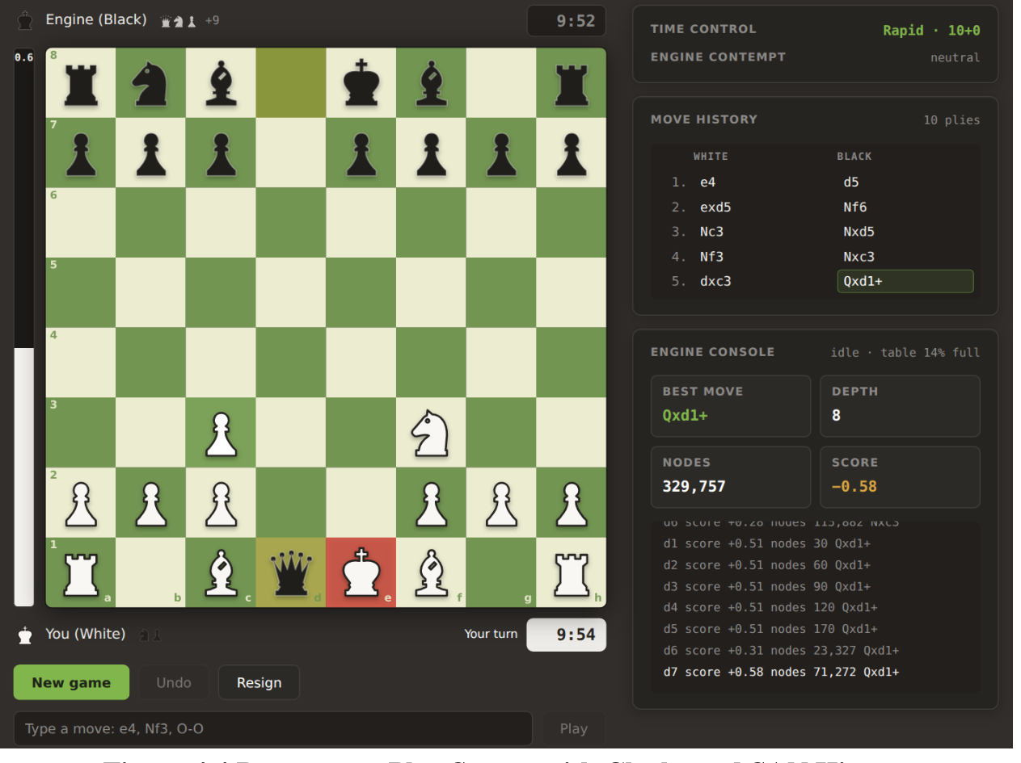
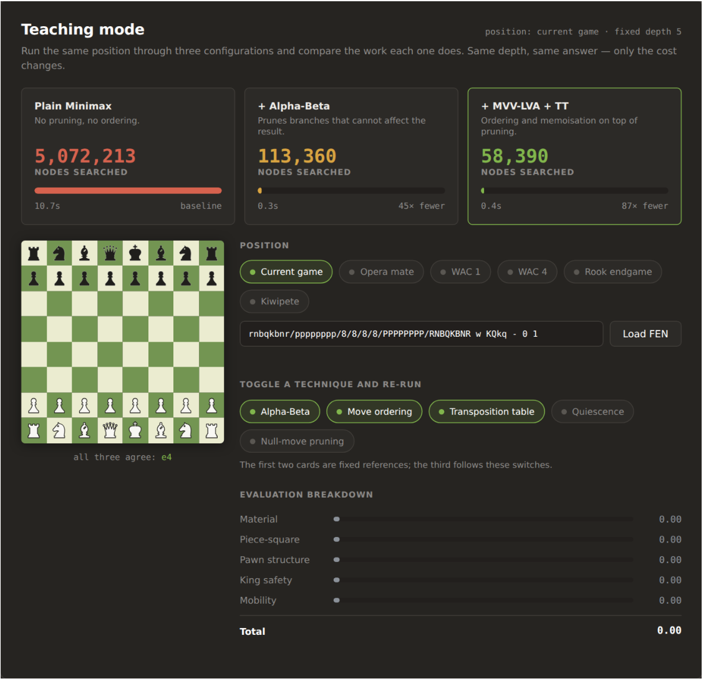
User Interface / Implementation Screenshots
Play screen: clocks, SAN history and engine telemetry
Teaching mode: search-cost comparison and FEN presets

Slide 18
Security Analysis (STRIDE)
Entry point | STRIDE threat | Risk | Control | Status
npm dependencies | Tampering – compromised package in build or bundle | Medium | Lockfile install (npm ci); 53 tests before every build | In place
CI deploy secret | Information disclosure – leaked token can publish the site | Medium | Encrypted GitHub secret; scoped service account next | Partial
Workflow trigger | Elevation – deploy step also runs on pull requests | Medium | Deploy only on push to main | Planned
Headers & fonts | Information disclosure – no CSP; third-party font request | Low | CSP, nosniff, Referrer-Policy; self-hosted fonts | Planned
Typed moves & FEN | Tampering – malformed input corrupts game state | Low | FEN validation; legal-move matching; React escaping | In place
Engine worker | Denial of service – runaway search freezes the page | Low | Web Worker, time budget, 60 s cap, fixed 10 MB table | In place
Release pipeline | Tampering – engine or rules regression reaches users | Low | Perft + 53-test gate on every deploy | In place
Client-side only: no backend, accounts or stored personal data — game state never leaves the browser.

Slide 19
Challenges Faced and Solutions
Horizon effect
Capture-only quiescence extends tactical exchanges; remaining blind spot: checks at leaves.
Null-move tactical error
A too-permissive guard missed a mate; fixed with a minimum four-ply condition.
Hash-table distribution
Switched Zobrist key generation to Mulberry32; bounded the table to 10 MB.
UI + delivery reliability
SVG pieces, better mobile rendering, corrected cache rules; tests gate CI builds.
Remaining: search checks in quiescence; improve quiet move ordering; strengthen CI/CD security headers and credentials.

Slide 20
Work Plan Until Final Review
1 · SEARCH ACCURACY
Implement check evasions in quiescence; add killer/history ordering and check extensions.
2 · OPTIMISATION
Update Zobrist hashes incrementally; display only the last completed iteration depth.
3 · SECURITY
Tighten deployment to main pushes; add CSP headers, scoped credentials and dependency scanning.
4 · FINAL REVIEW
Finalise and submit the IEEE paper; broaden benchmarks to other opponents and time limits; rehearse the demo.
Milestones from Phase I Report, Chapter 5. Engine, deployment, report and IEEE paper draft are done.

Slide 21
References
[1] C. E. Shannon, “Programming a Computer for Playing Chess,” Philosophical Magazine, 1950.
[2] A. L. Zobrist, “A New Hashing Method with Application for Game Playing,” Tech. Rep. 88, Univ. of Wisconsin, 1970.
[3] D. E. Knuth and R. W. Moore, “An Analysis of Alpha-Beta Pruning,” Artificial Intelligence, 1975.
[4] R. E. Korf, “Depth-First Iterative-Deepening: An Optimal Admissible Tree Search,” Artificial Intelligence, 1985.
[5] J. Schaeffer, “The History Heuristic and Alpha-Beta Search Enhancements in Practice,” IEEE TPAMI, 1989.
[6] D. F. Beal, “A Generalised Quiescence Search Algorithm,” Artificial Intelligence, 1990.
[7] C. Donninger, “Null Move and Deep Search,” ICCA Journal, 1993.
[8] M. Campbell, A. J. Hoane Jr. and F. Hsu, “Deep Blue,” Artificial Intelligence, 2002.
[9] R. Coulom, “Efficient Selectivity and Backup Operators in Monte-Carlo Tree Search,” Computers and Games, 2006.
[10] D. Silver et al., “A General Reinforcement Learning Algorithm that Masters Chess, Shogi, and Go through Self-Play,” Science, 2018.
[11] S. Russell and P. Norvig, Artificial Intelligence: A Modern Approach, 4th ed., Pearson, 2020.
[12] A. Shostack, Threat Modeling: Designing for Security, Wiley, 2014.
[13] Chess Programming Wiki, “Perft Results,” chessprogramming.org/Perft_Results.
[14] The Stockfish developers, Stockfish 19 (reference engine for benchmarks), stockfishchess.org.
[15] SaIdEeVaN, FOAI-Project (source, benchmarks and REPORT.md), github.com/SaIdEeVaN/FOAI-Project.

Slide 22
Thank You
Adversarial State-Space Optimization in Chess Environments
Live demo: foai-chess-engine.web.app
Code and experiments: github.com/SaIdEeVaN/FOAI-Project

